Slide 1

Welcome to Year 2
“We work, learn, play and pray together fulfilling God's unique plan
for each and every one of us.”

Slide 2
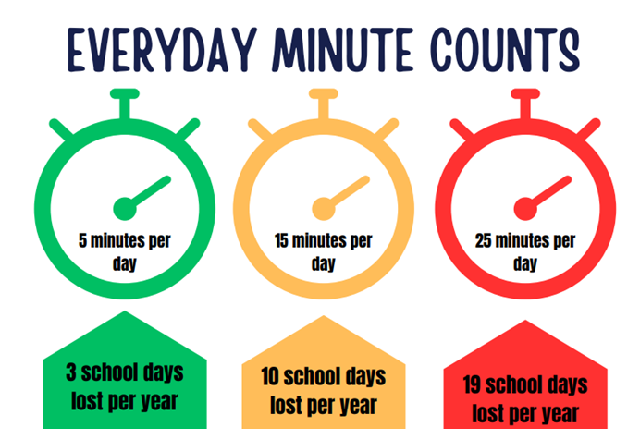

Morning Registration
The Beginning of the School Day
All children are expected to be in by 8:40am
Gates open at 8:30am and closes at 8:40am
Registration opens at 8:40am and closes at 8:55am
If children are not in school by 8:55a.m they will be marked as late and if they arrive after 9am – they will be marked as an unauthorised absence.

Slide 3

An Example of our School Day
8:40am Registration
8:40 – 9am Early morning work
9-9:30am Assembly
9:30-10:30am – Maths
10:30-10:45am – Break
10:45am-11.10am – Guided reading
11:15-12:00am – English
12-1pm – Lunch
1-1:20pm - Phonics
1:20– 2:15pm – Geography
2.20-3.00pm PE
3:15pm – Home time
Our PE day is Tuesday

Slide 4

School Uniform
All children must be in the correct uniform everyday.
All clothing must be labelled so we can return lost items easily.
Please remember:
School shoes – not trainers
Earrings must be a small, plain stud
No big bags – we don’t have enough room on the pegs, please use our school bags

Slide 5
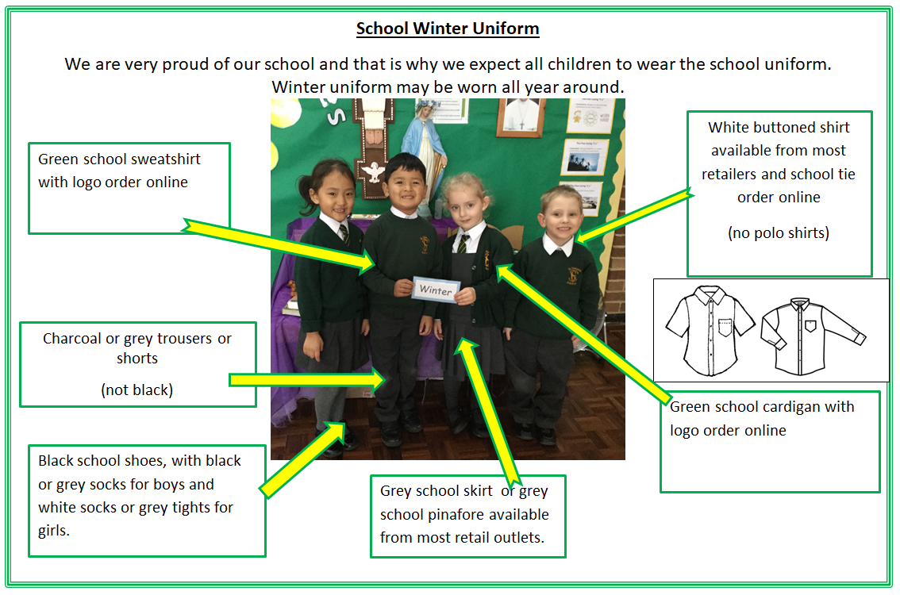
Winter School Uniform
Terms 1, 2, 3 and 4

Slide 6
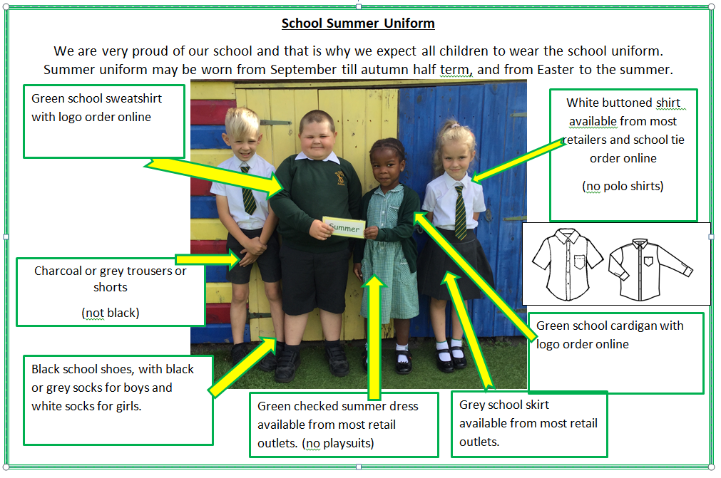
Summer Uniform
Terms 5 and 6

Slide 7

Communication with parents and carers
Parents can communicate with us via:
Telephone 01233 623199
Email: office@st-simons-ashford.kcsp.org.uk
Make an appointment through the school office
Speak to the class teacher at pick up
During parents evenings and appointments
Our school website: www.st-simon.kent.sch.uk
Mrs Bryant’s weekly newsletter

Slide 8

Parent / Teacher Meetings
Throughout the academic year:
    2 parent consultation meetings
    2 book looks
Dates to be confirmed

Slide 9

Lunches
We are a healthy school so only healthy lunches and snacks
No nuts
No fizzy drinks
Only water in all children’s class water bottles

Slide 10

Keeping Us Informed
Please keep us informed regarding anything that may affect your child in school:
Any change in family circumstance- illness, bereavement etc.
Up to date contact details- address, mobile phone, email address etc.

Slide 11

Absence and Absence Reporting
Attendance- All KCSP schools have now introduced an attendance policy which will mean that we will now be introducing fixed penalty notices for parents with children with poor attendance or persistent unauthorised absences.
All absence must be reported by telephone on first day of absence by 8:30am and then followed up with a written note on return
It is now government policy that no holidays are allowed to be authorised during term time

Slide 12

St Simon’s Is Cashless
At school we no longer take cash payments.
For all payments: parents and carers will need a Parent Pay account- the school office provide all parents and carers with a username and password with details on how to activate their account
If parents need help with accounts please contact the school office
All school meals must be paid for in advance school

Slide 13
SEND
If you have any new concerns regarding S.E.N.D and your child please contact the class teacher
If necessary, we can arrange a further meeting with Mrs Chambers the School SENCO
Appointments with Mrs Chambers can be arranged via the school office

Slide 14
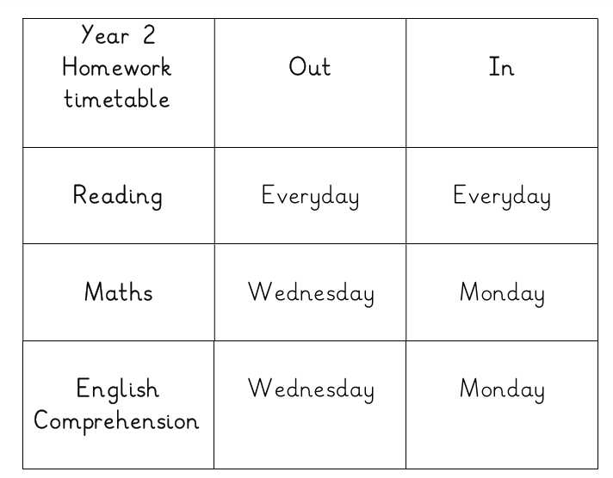

Homework
Homework will be set weekly
Given on a Wednesday
Return to the teacher on Monday
We expect children to be reading daily on top of the homework set on a Wednesday

Slide 15



Curriculum – Term 1
Maths: Place value and Addition and subtraction
English: The snail and the whale
Journey story: describe a settings, describe a character, letter giving an opinion and letter asking for help
Poetry Pie Roger McGough
RE – Creation and covenant
Topic Science : Living things and their habitats
Computing: Coding
Geography: UK: What kind of place is it?
Art : Drawing
Physical Education : Dance
French: Transport
A full curriculum overview will be uploaded to our class pages shortly.

Slide 16


We Need Your Help!
St Simon’s PTA
We need volunteers to help run and organise school events such as school discos, Christmas and Summer Fairs.
These events cannot happen unless we have parents and carers who are prepared to run them
The PTA are in the hall now if you would like to have a chat with them to share any ideas or can help at any of the events coming up – thank you in advance

Slide 17
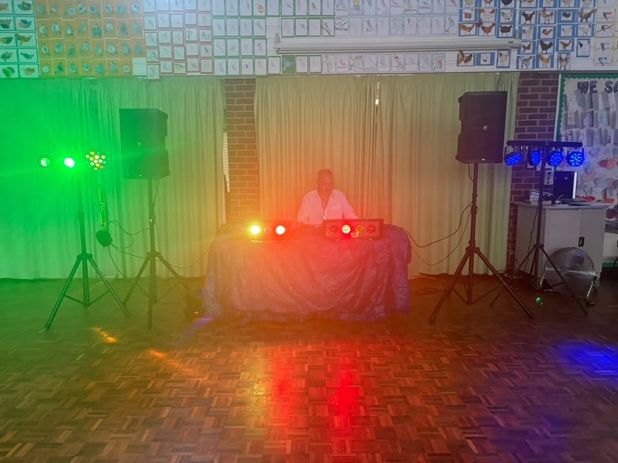
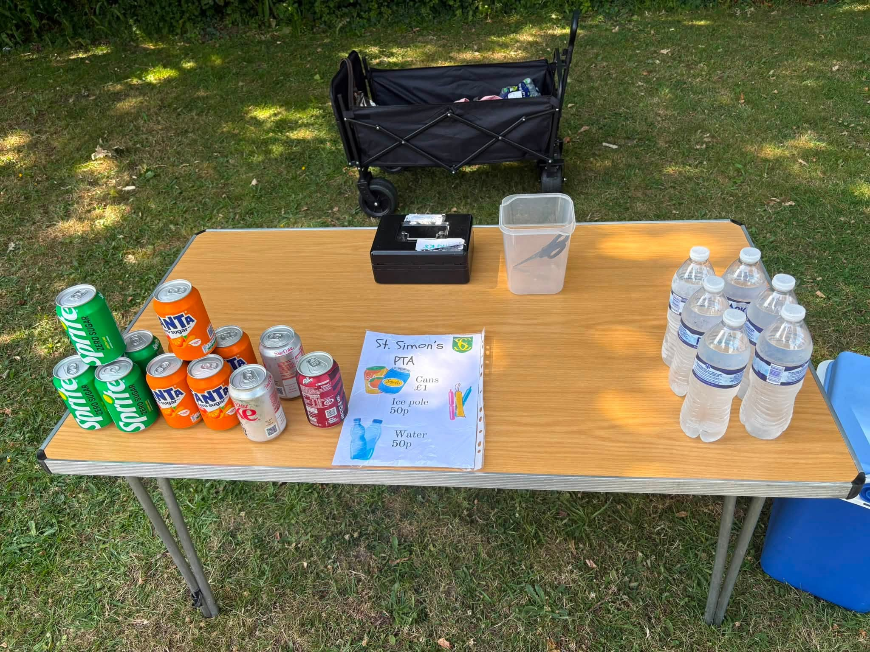
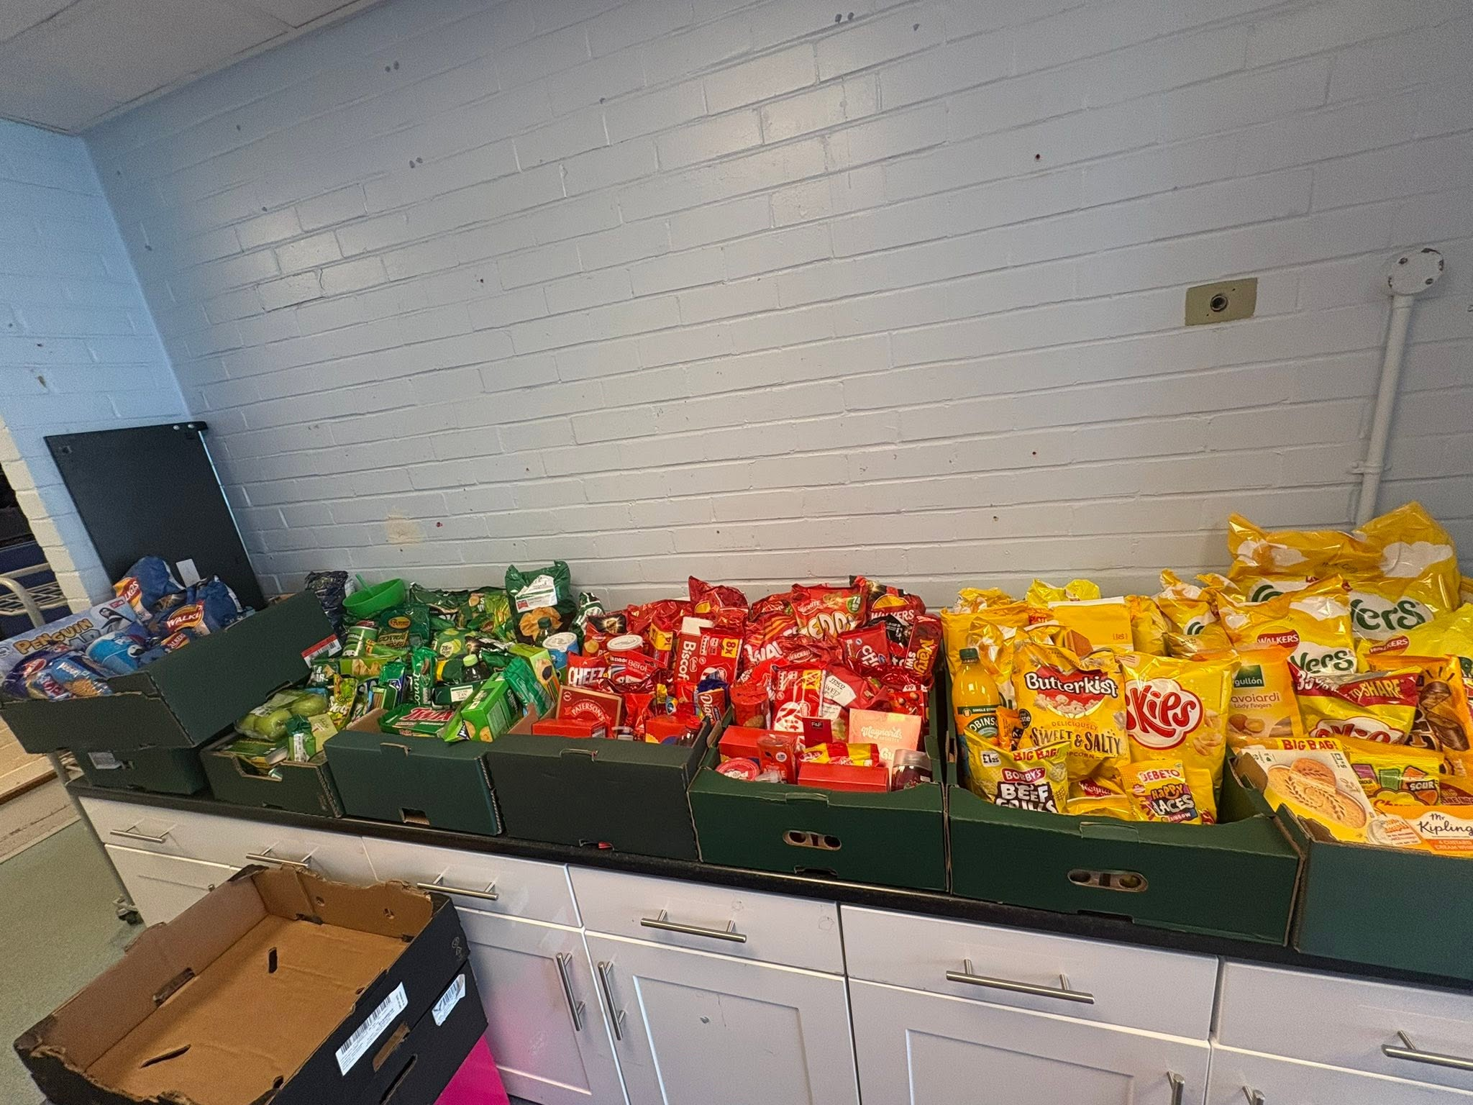
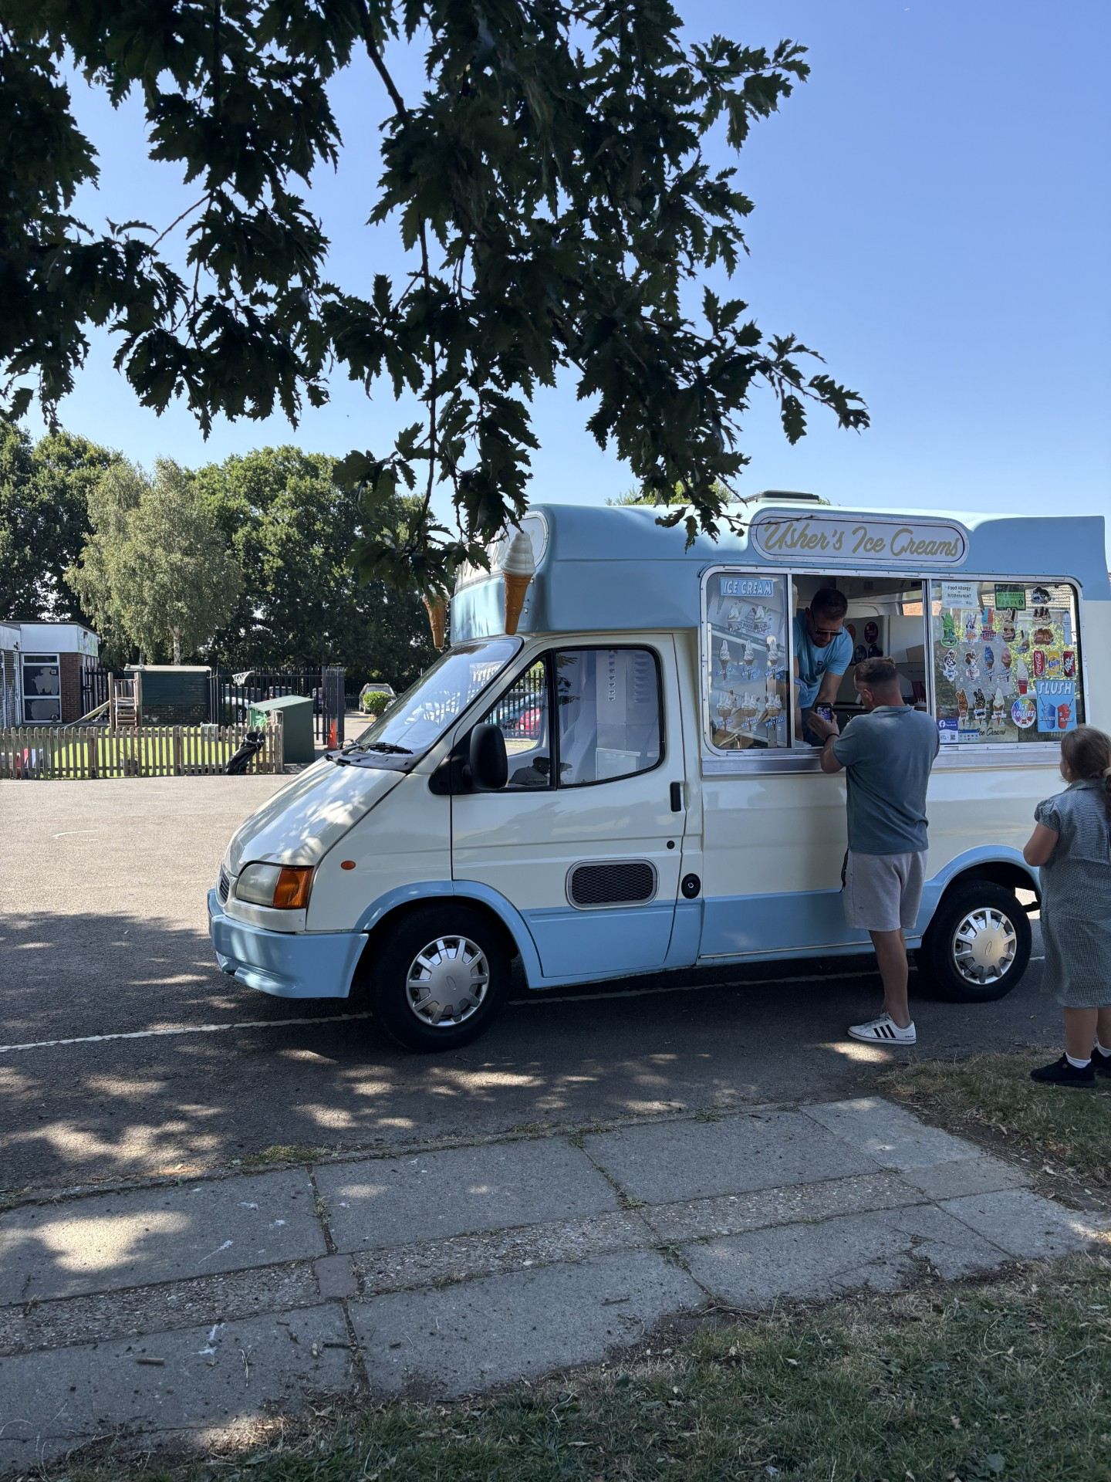
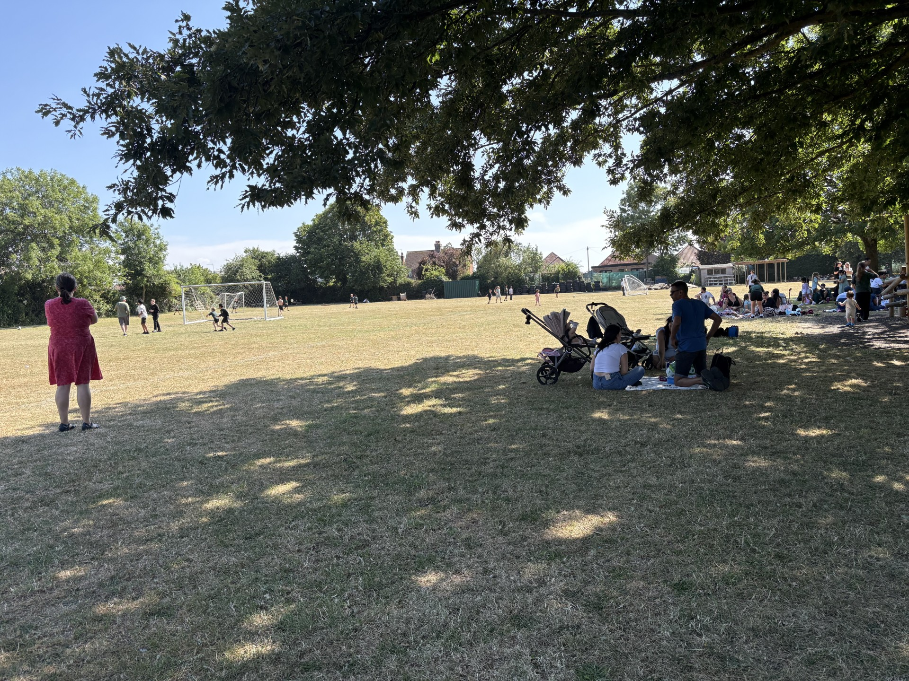

St Simon’s Primary School PTFA
We need your help!
AGM – Thursday 1st October 5.15pm in the school hall
Committee roles available
Chair
Secretary
Treasurer
No previous experience needed.
Help us continue providing fun experiences and fundraising opportunities for our children.
Visit us in the hall today
Meet some of the team
Find out how you can help
Guess the number of sweets in the jar!
£1,426 raised last term!!
To contact the PTFA please email: stsimonspta@gmail.com

Slide 18

Any Questions?

